Slide 1
App Service API Apps

Slide 2
Agenda
Why Use a Managed API Service?
Azure App Service
API Apps
Authoring API Apps
Consuming API Apps
Integration & Architecture

Slide 3
Why Use a Managed API Service?

Slide 4




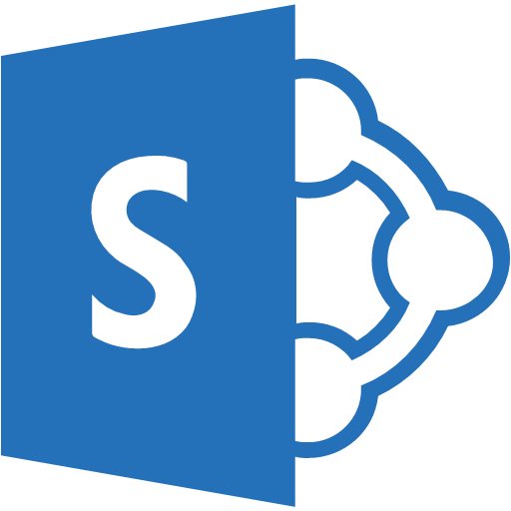


Problems with Authoring APIs
Integration is Difficult
On Premise Applications
Databases in Azure VMs
SharePoint Online
Cloud-Hosted Web Apps

Slide 5




Problems with Authoring APIs
Requires Additional Investment
Web Service
Continuous Deployment Tool
Cutover/Versioning Utility
Authentication Suite
Monitoring Solution

Slide 6

Problems with Authoring APIs
Difficult to Consume
Web Service
Internal Developers
Sparse Code Comments
Integration Testing Debt
External Developers
Lack of Documentation
Inconsistent Metadata
Business Users
Can’t use at all!
Products API
Customers API
Inventory API

Slide 7
Azure App Service

Slide 8


Azure App Service Build and scale great cloud apps
Web Apps
Mobile Apps
Logic Apps
API Apps

Slide 9



Web Apps
Logic Apps
Mobile Apps
Administration App
Customer site
Order Completed
Customer App
http
SQL
API Apps

Slide 10
Develop apps with…
.NET | Node.js | PHP | Python | Java

Slide 11
Continuous integration

Slide 12
Web Apps
Logic Apps
Mobile Apps
Administration App
Customer site
Order Completed
Customer App
http
SQL
API Apps

Slide 13
API Apps

Slide 14
Easily use cloud or custom APIs:
Dozens of built-in APIs for popular SaaS
An ecosystem of APIs for any need
Create and publish custom, reusable APIs
Visual Studio tooling with one click publish and remote debugging
Automatic client SDK generation for many languages
Api Apps
Create, consume and
host APIs more easily

Slide 15
Azure API Apps provide a rich platform and ecosystem for building, consuming, and distributing APIs in the cloud and on-premises.

Slide 16
Benefits of App Services
Automatic OS patching
Enterprise-grade security
High availability
Automated scale out/in
Built-in load balancing
Supports many languages and platforms
.NET, Node.js, Python, Ruby and many more
Easy continuous deployment
Continuous delivery from third-party source control providers
Built-in Git repo

Slide 17
Benefits of API Apps
Bring your API as-is
.NET Web API
Node.js + Express
Java
PHP
Many other technologies
Connect easily to SaaS platforms

Slide 18
Benefits of API Apps
Integrated Swagger metadata
Easy connectivity to Logic Apps
Built-in Visual Studio tooling/support
Automatic dependency management and updates
Marketplace support
Private API gallery (NuGet feed)
Public Azure marketplace

Slide 19
Enterprise connectivity
Dynamics
SQL
SAP
Oracle

Slide 20
Authoring API Apps

Slide 21
API App Templates
Don’t like the templates? Roll out your own API App!

Slide 22
Authoring API Apps
Authoring
Package and Publish
Use WebDeploy like Web Apps
Use local Git repo
Publish to the Marketplace (coming soon)
Metadata about Web Service forms Contract
Done using Swagger 2.0 for your platform of choice
Metadata makes API “discoverable”
SSO or security aspects are handled at the server level, not the app
Easily build Microservices

Slide 23
Demo: Create an API App

Slide 24
Access Levels
Public (anonymous)
Anyone can call the API app from outside the resource group without being logged in.
Public (authenticated)
Only authenticated users are allowed to call the API app from outside the resource group.
Internal
Only other API apps in the same resource group are allowed to call the API app.

Slide 25
Public (Authenticated) Access Level
API App Access
Azure Active Directory
Microsoft Account
Social Identities
Facebook
Google
Twitter

Slide 26
Consuming API Apps

Slide 27
API Apps addresses key pains around building and consuming APIs
Build your API
Consume APIs
Web Apps++: Bring you API as is in your language of choice
API discovery
SDK generation
SSO, handled by server
Authentication, built-in to mobile and web SDKs
Expose enterprise APIs
Microservice style
Metadata contract
SSO
Simple access control
Gallery – public & organization

Slide 28
Simplifying Integration
Managed Middle Tier
API App[s]
On Premise Applications
Databases in Azure VMs
SharePoint Online
Cloud-Hosted Web Apps
SSO, Auth, Scale, etc.

Slide 29
Consuming API Apps
API Apps expose HTTP services
Metadata is exposed using Swagger 2.0 metadata
JSON file
Widely supported
Client applications

Slide 30
Demo: Connecting to an API App

Slide 31
Swagger
Engine that provides a JSON representation of your API for integration with various frameworks, applications and tools
Swagger metadata is a description of the capabilities of your API application
http://swagger.io/

Slide 32
Swagger
Through dynamic metadata you can generate:
Interactive documentation
Client SDK
Discoverable endpoints
Integrates into many services and frameworks including
JavaScript, Node.js, .NET, Java, Go, Groovy, PHP
Already supported in the API Management service
Already supported in many tools:
Postman, Runscope, SoapUI

Slide 33
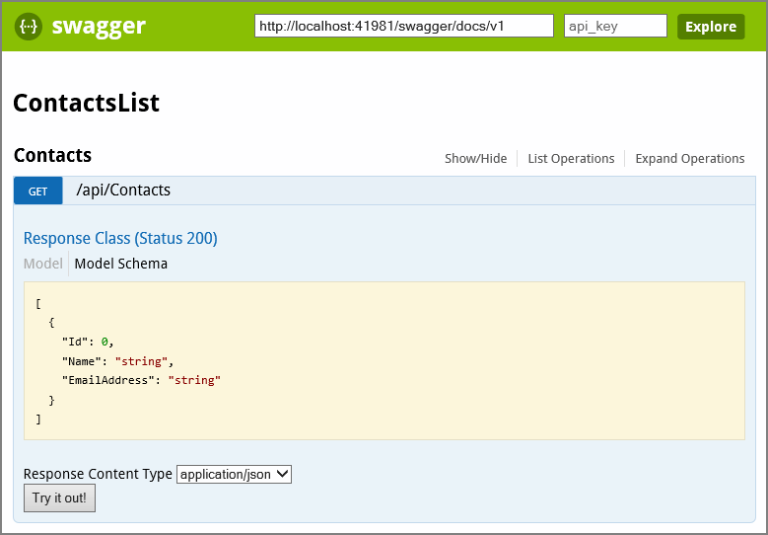
Swagger UI
Automatically generated User Interface to view metadata and documentation for each service endpoint

Slide 34
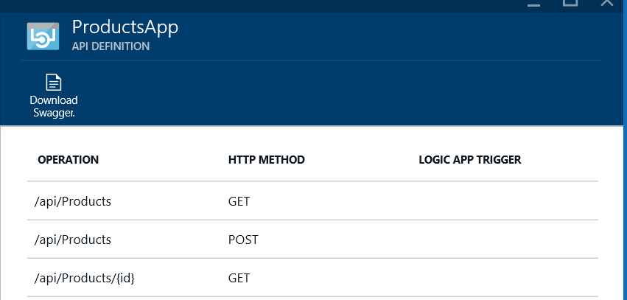
Preview Portal
The Azure Preview Portal can visualize your API for you
You can also download the JSON Swagger metadata directly from the portal

Slide 35
Demo: Viewing the Metadata for an API App

Slide 36
Integration & Architecture

Slide 37
API Apps Architecture Example
Backend is an API App with APIs from the gallery, as well as custom code. It is registered with and protected by AAD. Logins to downstream SaaS are facilitated by a consent server and token store, using a server flow.
API App Gateway
Resource Group – App Service
API App Gateway
Runtime
Name resolution
Isolated storage
Shared config
API App Gateway
API Apps from Gallery
Custom Code
On-premises
Salesforce Connector
Mobile App (Data Access)
Clients
Web
Mobile (iOS)
Flow
Azure AD
Proxy
API logging
API access level
Transforming API definition
Office 365 Connector
Direct deployed
3rd party SaaS
Identity Broker
AAD & social login
Secure token store
Consent server for SSO
Logic Apps
Twilio Connector
Logic App Definitions
Azure AD
Logic App (also from gallery)
Consent Server
Facilitates SaaS login and token refresh
Token Store
Isolated storage
Shared config
other Azure services…
Secure token store

Slide 38
API App Templates
App Templates are available today to connect to your favorite SaaS services

Slide 39
SaaS integration

Slide 40


Microsoft Integration
+
BizTalk Server
BizTalk Services
Azure App Service
Leader in integration on-premises
Handles mission critical workloads for hundreds of customers
Renowned brand
First version of BizTalk build ‘cloud-up’
Already running mission critical workload for large customers
Includes BizTalk Services capabilities – evolved to benefit from App Service approach
Inherently extensible
More accessible to a broader audience, not just integration specialists
Takes BizTalk brand and capabilities forward

Slide 41
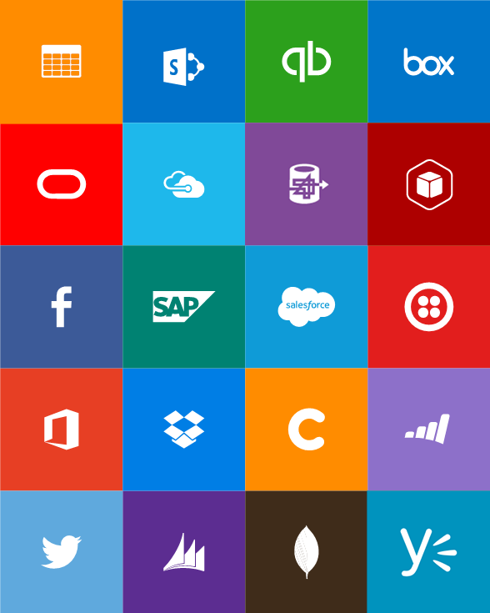
Built-in API Connectors
Box
Chatter
Delay
Dropbox
Azure HD Insight
Marketo
Azure Media Services
OneDrive
SharePoint
SQL Server
Office 365
Oracle
QuickBooks
SalesForce
Sugar CRM
SAP
Azure Service Bus
Azure Storage
Timer / Recurrence
Twilio
Twitter
IBM DB2
Informix
Websphere MQ
Azure Web Jobs
Yammer
Dynamics CRM
Dynamics AX
Hybrid Connectivity

Slide 42
Protocols
HTTP, HTTPS
File
Flat File
FTP, SFTP
POP3/IMAP
SMTP
SOAP + WCF
BizTalk Services
Batching / Debatching
Validate
Extract (XPath)
Transform (+Mapper)
Convert (XML-JSON)
Convert (XML-FF)
X12
EDIFACT
AS2
TPMOM
Rules Engine

Slide 43
Connecting to On-Premises Data
Hybrid Connections
Allows Web Apps, Mobile Apps, and Logic Apps to access existing on-premises data
Multiple apps can share a hybrid connection
TCP ports for network access to specific resources
Group Policy settings, event and audit logs
Virtual Networks
Industry standard site-to-site and point-to-site IPSec VPN.
Allows access to your local network.

Slide 44
Try App Service: API Apps today
https://tryappservice.azure.com
Ask Questions:
Twitter:
Email
Public forum:

Slide 45
Q&A

Slide 46


Get started
Visit azure.microsoft.com

